Slide 1
Summary: The following slides may be leveraged to present the three primary components of the Framework and how they are intended to be used.
Audience: These slides are intended for an audience who is new to the Framework with no previous knowledge or understanding of its components.
Learning Objectives:
Distinguish the characteristics within the four Implementation Tiers
Recognize the cybersecurity taxonomy and hierarchy within the Framework Core
Understand the goals of a Framework Profile

Slide 2

Components of the Cybersecurity Framework
July 2018
cyberframework@nist.gov

Slide 3
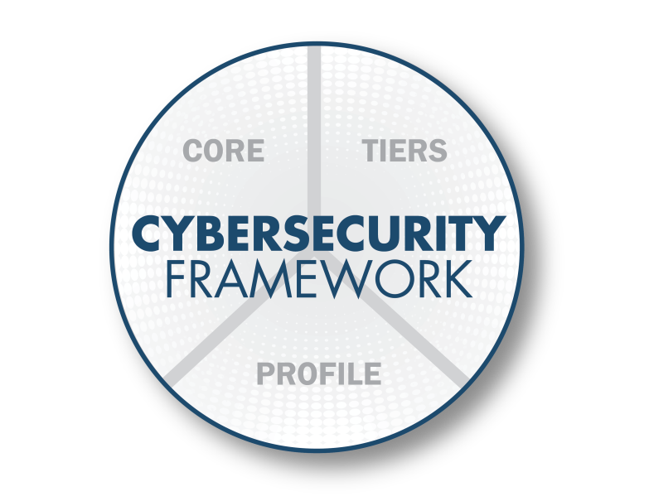
Cybersecurity Framework Components
The Framework consists of 3 main components
Notes:
Three main components of the Framework:
Framework Implementation Tiers
Describes how cybersecurity risk is managed by an organization
Describes degree to which an organization’s cybersecurity risk management practices exhibit the key characteristics (e.g., risk and threat aware, repeatable, and adaptive)
Tier options: Partial (Tier 1), Risk-Informed (Tier 2), Risk-Informed and Repeatable (Tier 3), Adaptive (Tier 4)
Each organization will decide which tier matches its risk management needs and capabilities. It is not a race to the top.
Framework Core:
Cybersecurity activities and informative references, organized around particular outcomes. Enables communication of cyber risk across an organization.
Consists of Functions, Categories, Subcategories, and Informative References
Functions: Identify, Protect, Prevent, Respond, Recover
Framework Profile:
Aligns industry standards and best practices to the Framework Core in a particular implementation scenario.
Supports prioritization and measurement while factoring in business needs.
Helps organizations progress from current level of cybersecurity sophistication to a target improved state.

Slide 4
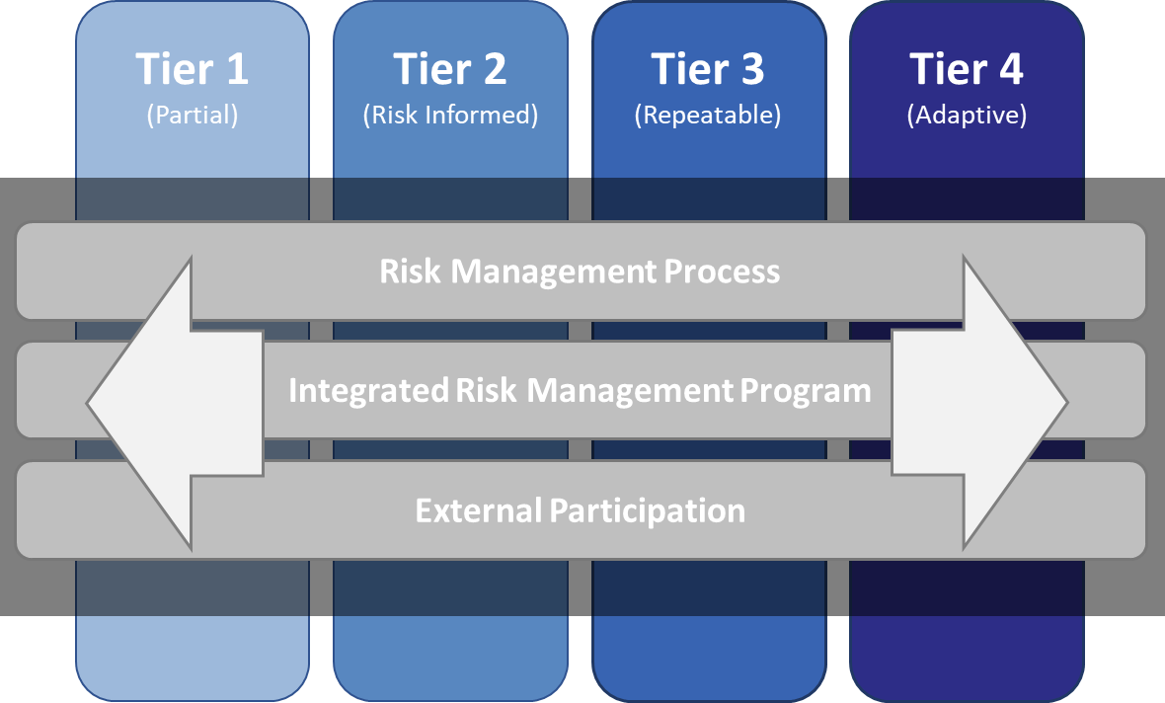
Framework Implementation Tiers
4
Notes:
Tiers provide context on how an organization views cybersecurity risk and the processes in place to manage that risk as defined below:
Risk Management Process: The functionality and repeatability of cybersecurity risk management
Integrated Risk Management Program: The extent to which cybersecurity is considered in broader risk management decisions
External Participation: The degree to which the organization benefits my sharing or receiving information from outside parties
The Tiers range from Partial (Tier 1) to Adaptive (Tier 4) and describe an increasing degree of rigor and sophistication in cybersecurity risk management processes, how well integrated cyber risk decisions are into broader risk decisions, and the degree to which the organization shares and receives cybersecurity info from external parties.
Tiers do not represent maturity levels. Organizations should determine the desired Tier, ensuring that the selected level meets organizational goals, is feasible to implement, and reduces cybersecurity risk to levels acceptable to the organization.

Slide 5
Framework Core
 | Function | Category | ID
What processes and assets need protection? | Identify | Asset Management | ID.AM
 |  | Business Environment | ID.BE
 |  | Governance | ID.GV
 |  | Risk Assessment | ID.RA
 |  | Risk Management Strategy | ID.RM
 |  | Supply Chain Risk Management | ID.SC
What safeguards are available? | Protect | Identity Management & Access Control | PR.AC
 |  | Awareness and Training | PR.AT
 |  | Data Security | PR.DS
 |  | Information Protection Processes & Procedures | PR.IP
 |  | Maintenance | PR.MA
 |  | Protective Technology | PR.PT
What techniques can identify incidents? | Detect | Anomalies and Events | DE.AE
 |  | Security Continuous Monitoring | DE.CM
 |  | Detection Processes | DE.DP
What techniques can contain impacts of incidents? | Respond | Response Planning | RS.RP
 |  | Communications | RS.CO
 |  | Analysis | RS.AN
 |  | Mitigation | RS.MI
 |  | Improvements | RS.IM
What techniques can restore capabilities? | Recover | Recovery Planning | RC.RP
 |  | Improvements | RC.IM
 |  | Communications | RC.CO
Notes:
The Framework Core consists of five high level functions: Identify, Protect, Detect, Respond, and Recover (IPDRR)
Next level down is just 22 categories split across the 5 functions.
The Core was designed to cover the entire breadth, while not being overly deep. It covers topics across cyber, physical, and personnel.

Slide 6
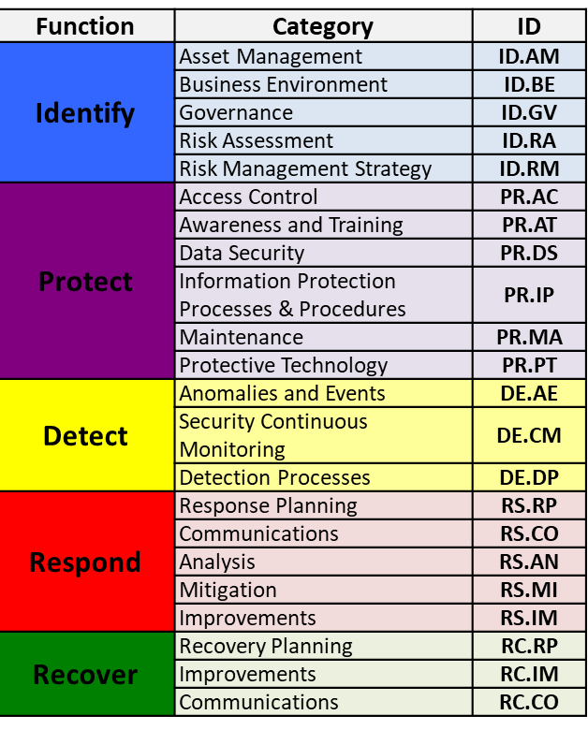
Core: A Translation Layer
Senior Executives
Broad enterprise considerations
Abstracted risk vocabulary
Specialists in Other Fields
Implementation / Operations
Specific focus outside of cybersecurity
Specialized or no risk vocabulary
Deep technical considerations
Highly specialized vocabulary
Notes:
The Framework Core is designed to be intuitive.
The Core can be thought of as a translation layer that takes cybersecurity and translates it to other disciplines.
It uses simple language to make it accessible to all parties regardless of field or technical knowledge, while still remaining relevant to those who are technical.

Slide 7
Subcategories & Informative References
Function | Category | ID
Identify | Asset Management | ID.AM
 | Business Environment | ID.BE
 | Governance | ID.GV
 | Risk Assessment | ID.RA
 | Risk Management Strategy | ID.RM
 | Supply Chain Risk Management | ID.SC
Protect | Identity Management & Access Control | PR.AC
 | Awareness and Training | PR.AT
 | Data Security | PR.DS
 | Information Protection Processes & Procedures | PR.IP
 | Maintenance | PR.MA
 | Protective Technology | PR.PT
Detect | Anomalies and Events | DE.AE
 | Security Continuous Monitoring | DE.CM
 | Detection Processes | DE.DP
Respond | Response Planning | RS.RP
 | Communications | RS.CO
 | Analysis | RS.AN
 | Mitigation | RS.MI
 | Improvements | RS.IM
Recover | Recovery Planning | RC.RP
 | Improvements | RC.IM
 | Communications | RC.CO
Subcategory | Informative References
ID.BE-1: The organization’s role in the supply chain is identified and communicated | COBIT 5 APO08.04, APO08.05, APO10.03, APO10.04, APO10.05 ISO/IEC 27001:2013 A.15.1.3, A.15.2.1, A.15.2.2 NIST SP 800-53 Rev. 4 CP-2, SA-12
ID.BE-2: The organization’s place in critical infrastructure and its industry sector is identified and communicated | COBIT 5 APO02.06, APO03.01 NIST SP 800-53 Rev. 4 PM-8
ID.BE-3: Priorities for organizational mission, objectives, and activities are established and communicated | COBIT 5 APO02.01, APO02.06, APO03.01 ISA 62443-2-1:2009 4.2.2.1, 4.2.3.6 NIST SP 800-53 Rev. 4 PM-11, SA-14
ID.BE-4: Dependencies and critical functions for delivery of critical services are established | ISO/IEC 27001:2013 A.11.2.2, A.11.2.3, A.12.1.3 NIST SP 800-53 Rev. 4 CP-8, PE-9, PE-11, PM-8, SA-14
ID.BE-5: Resilience requirements to support delivery of critical services are established | COBIT 5 DSS04.02 ISO/IEC 27001:2013 A.11.1.4, A.17.1.1, A.17.1.2, A.17.2.1 NIST SP 800-53 Rev. 4 CP-2, CP-11, SA-14
7
Notes:
Subcategories are the deepest level of abstraction in the Core. There are 97 subcategories, which are outcome-driven statements that provide considerations for creating or improving a cybersecurity program.
The subcats shown are 5 from Business Environment category.
The other column, is for Informative References. These informative references are broad references that are more technical than the framework itself.
The Framework is designed to be coupled. So, organizations often use these control catalogs such as NIST SP800-53, COBIT, ISO 27001, etc. to obtain more technical guidance.

Slide 8

Framework Profiles
Alignment with business requirements, risk tolerance, and organizational resources
Enables organizations to establish a roadmap for reducing cybersecurity risk
Used to describe current state or desired target state of cybersecurity activities
Notes:
Alignment of Functions, Categories, and Subcategories with business requirements, risk tolerance, and resources of the organization
Enables organizations to establish a roadmap for reducing cybersecurity risk that is well aligned with organizational and sector goals, considers legal/regulatory requirements and industry best practices, and reflects risk management priorities
Can be used to describe current state or desired target state of cybersecurity activities

Slide 9
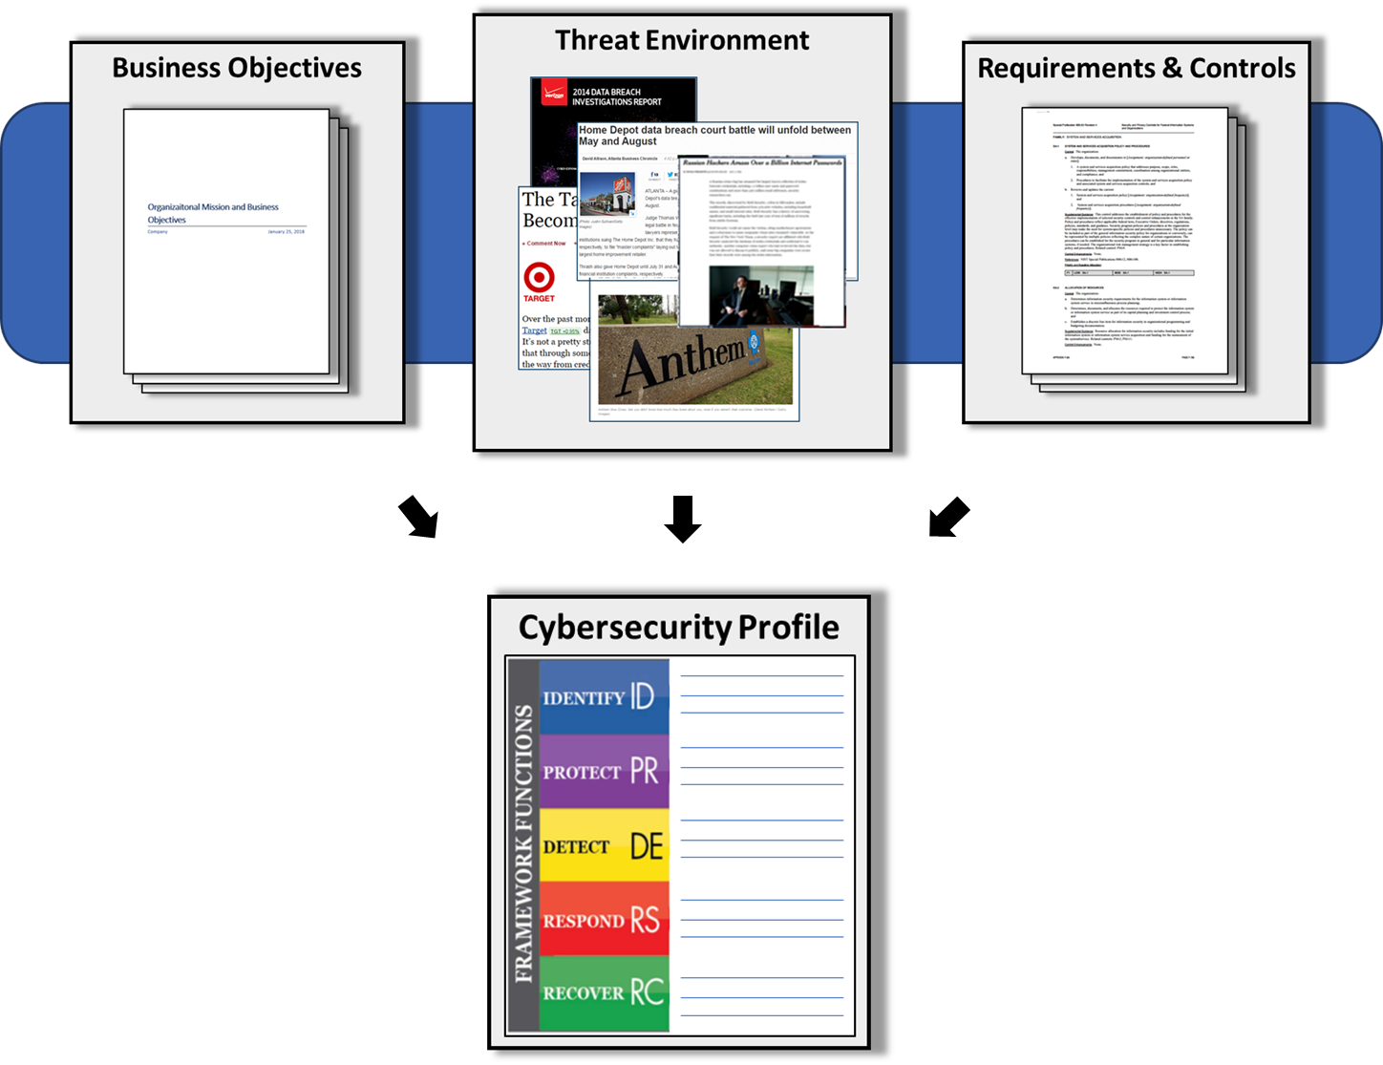
Building a Profile
Notes:
Profiles are about optimizing the Cybersecurity framework to best serve the organization. The Framework is voluntary, so there is no ‘right’ or ‘wrong’ way to do it.
This is just one way of approaching profiles.
An organization can map their cybersecurity requirements, mission objectives, and operating methodologies, along with current practices against the subcategories of the Framework Core.
These requirements and objectives can be compared against the current operating state of the organization to gain an understanding of the gaps between the two.

Slide 10
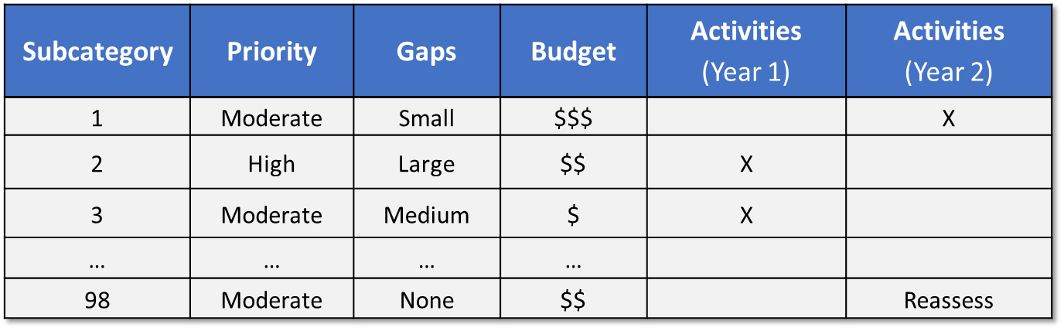
Resource and Budget Decision Making
…and supports on-going operational decisions, too
Notes:
The creation of these profiles, and the gap analysis allows organizations to create a prioritized roadmap. The priority, size of gap, and estimated cost of the corrective actions help organizations plan and budget cybersecurity activities.
The voluntary and flexible nature of this Framework lends it to being extremely cost effective and can be used by organizations to prioritize cybersecurity activities regardless of its budget.

Slide 11
Resources Where to Learn More and Stay Current
Framework for Improving Critical Infrastructure Cybersecurity and related news, information:
www.nist.gov/cyberframework
Additional cybersecurity resources: http://csrc.nist.gov/
Questions, comments, ideas: cyberframework@nist.gov

